Slide 1
SIMD on the CPU
SET10108 Concurrent and Parallel Systems

Slide 2
Breakdown
SIMD
SIMD on the CPU
Examples
Working with SIMD

Slide 3
SIMD

Slide 4
What is SIMD?
Single Instruction Multiple Data
SIMD underpins much of the work we have been doing up to this point
We create some data
We create multiple threads
We split the data across the threads
SIMD is a very useful approach to data parallelization

Slide 5
Why SIMD?
As stated, SIMD works best for data parallel problems
Many parallel problems can be broken down to have a data parallel part
SIMD provides a simple mechanism of thinking of our parallel problem
Get data
Split data across processors
Gather results
SIMD is also very effective for streaming data
GPU works on this principle

Slide 6
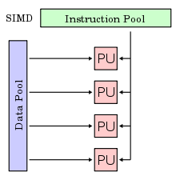
Basics of SIMD
SIMD works on the principle of splitting a data pool amongst multiple processing units
SIMD in its purest form should work on an instruction level
OpenMP is really a SPMD system – Single Program Multiple Data
The processor iterates through the data in the relevant chunk sizes

Slide 7
SIMD on the CPU

Slide 8
128-bit Registers
Modern CPUs (x86 and x86-64) have support for 128-bit registers on the CPU
This means that a 128-bit chunk (16 bytes) of memory can be stored on the CPU in one register
This allows the CPU to manipulate these 128-bit values in particular manners
We can treat them as a single large value
We can treat them as two 64-bit values
We can treat them as four 32-bit values
etc.

Slide 9
128-bit Values
C++ (or more truthfully C and Intel) provide a data type to support 128-bit values
__m128
This data type is the basis for working with SIMD operations
We can treat the number as different values to suit our purposes
Two doubles
Four ints
Four floats
etc.

Slide 10
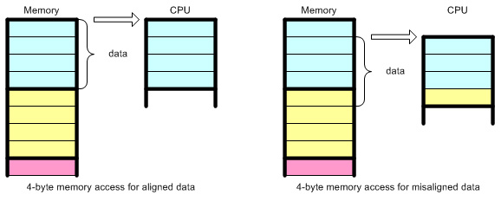
Memory Alignment
When working with 128-bit values we need to be careful about memory alignment
Memory alignment refers to how data is stored in memory
The cache reads data in chunks – we need to ensure the chunk holds all our data
The CPU then needs to ensure that it can also read the memory in chunks

Slide 11
SSE
Intel support for SIMD is handled by SSE
Streaming SIMD Extensions
SSE was first introduced in 1999 in response to AMD’s 3DNow
Originally Intel supported MMX
MMX works on integer data
SSE uses floating point data and has found wider acceptance
It became very popular in games development before GPGPU

Slide 12
Instructions
SSE introduced a number of instructions to support 128-bit operations
Four classifications
Arithmetic
Logical
Comparison
Conversion
_mm_add_ps
_mm_add_ss
_mm_mul_ps
_mm_sqrt_ps
_mm_cmple_ps

Slide 13
SSE2
SSE2 was introduced in 2001 with the Pentium 4
SSE2 adds further support for 128-bit values such as
Adding as two 64-bit values
Integer support
Cache protection
SSE2 is currently the most popular approach – it extends SSE with some new features which have proven useful

Slide 14
SSE3 & SSE4
SSE3 was introduced in 2004 with the Core 2
This provides a number of interesting instructions such as
Summing of registers
Dot product
SSE4 was introduced in 2007 with the i7
Again new instructions were added
These are very low level and useful in some application domains – we don’t really need to go beyond SSE

Slide 15
Examples

Slide 16

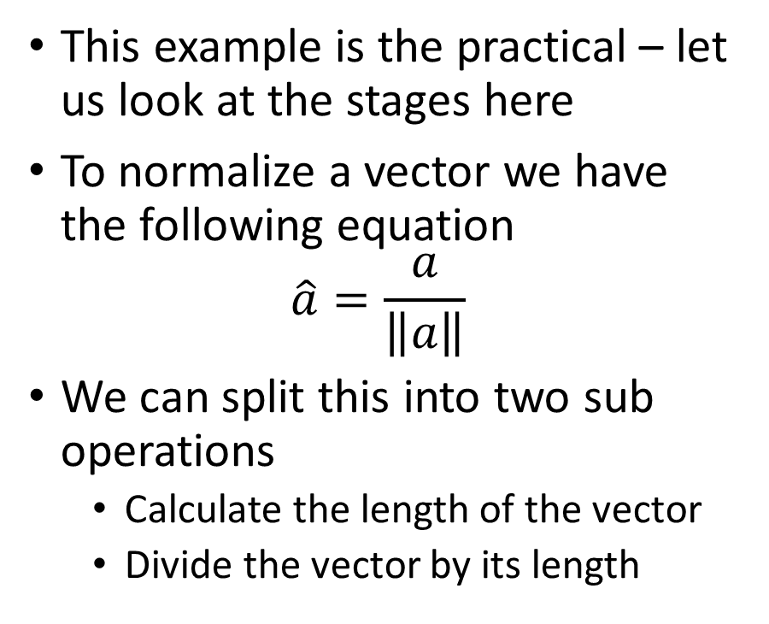
Normalizing a Vector
This example is the practical – let us look at the stages here
To normalize a vector we have the following equation
$$\hat{a}=\frac{a}{\left\|a\right\|}$$
We can split this into two sub operations
Calculate the length of the vector
Divide the vector by its length

Slide 17
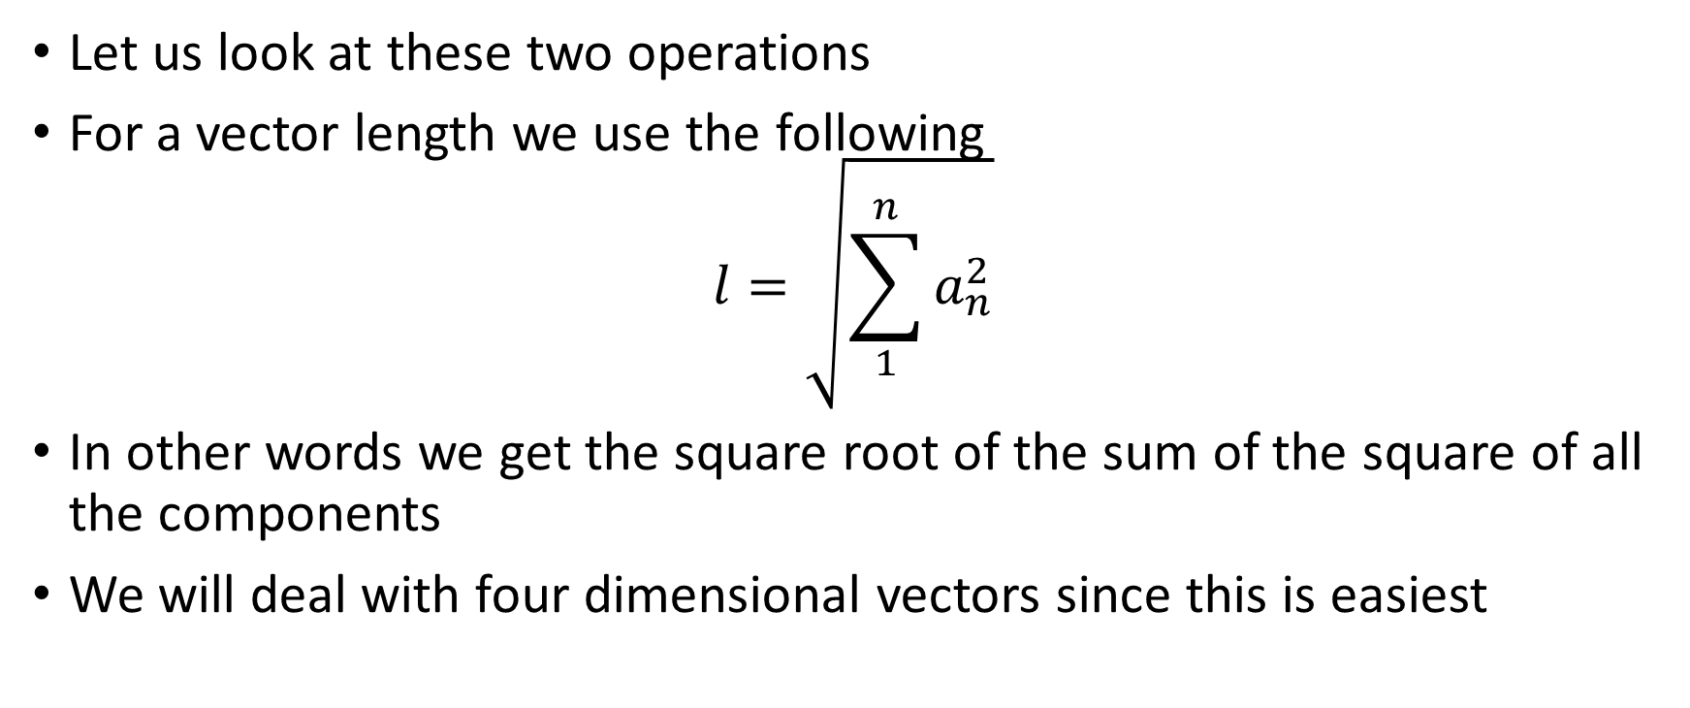
Normalizing a Vector
Let us look at these two operations
For a vector length we use the following
$$l=\sqrt{\sum_{1}^{n}{a_{n}^{2}}}$$
In other words we get the square root of the sum of the square of all the components
We will deal with four dimensional vectors since this is easiest

Slide 18
Normalizing a Vector
Breaking this down we have to do the following
Square the components
Sum the squares
Get the square root of the sum
The first step is easy in SIMD
See diagram

Slide 19
Normalizing a Vector
The next step cannot be performed as a standard SIMD operation
Sum the components
We therefore sum and store individually
We now have the squared length of the vector store in the components

Slide 20
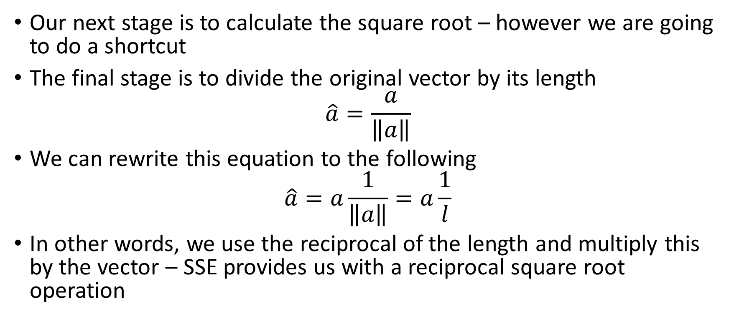
Normalizing a Vector
Our next stage is to calculate the square root – however we are going to do a shortcut
The final stage is to divide the original vector by its length
$$\hat{a}=\frac{a}{\left\|a\right\|}$$
We can rewrite this equation to the following
$$\hat{a}=a\frac{1}{\left\|a\right\|}=a\frac{1}{l}$$
In other words, we use the reciprocal of the length and multiply this by the vector – SSE provides us with a reciprocal square root operation

Slide 21
Normalizing a Vector
Using the reciprocal square root operation we get our scale to normalize each component in our vector
We can now multiply this by our original vector to get the normalized components
So a normalization has taken just 6 operations
2 multiplies
3 adds
Square root

Slide 22
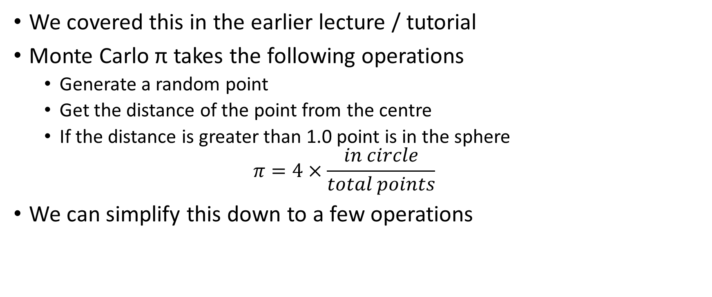
Monte Carlo π
We covered this in the earlier lecture / tutorial
Monte Carlo π takes the following operations
Generate a random point
Get the distance of the point from the centre
If the distance is greater than 1.0 point is in the sphere
$$π=4×\frac{in circle}{total points}$$
We can simplify this down to a few operations

Slide 23
Monte Carlo π
We need to calculate the vector length as before
This time we don’t need a square root – the length of interest is 1
We then use a comparison operator to compare the squared length with 1
We then add up the compared values
This provides the number of points in a spher

Slide 24
Working with SIMD

Slide 25
Library Support
SIMD is used quite a lot in mathematical libraries
GLM has support
DirectX uses special vectors
Bullet also uses SIMD operations (if not on the GPU)
SIMD is also automatically used under certain optimisation conditions
Compiler analyses code
If SIMD can be used apply to the code section
This is why you won’t see a performance difference when using SIMD if you don’t turn off optimisation

Slide 26
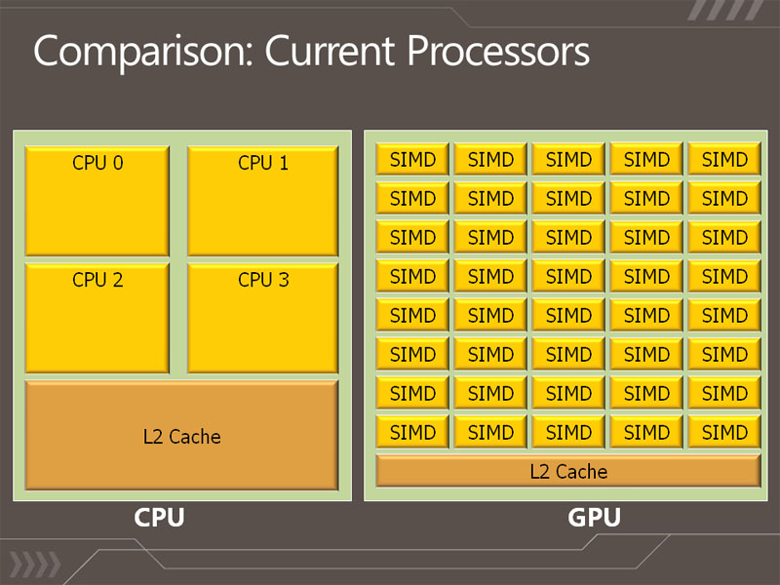
GPU and SIMD
The GPU uses SIMD to radically improve performance
Each small core in the GPU is a SIMD processor
Provides superior performance when dealing with the streaming style data of graphics
We will be using GPGPU later in the module – our work on SIMD here should help you understand it better

Slide 27
Parallelizing with SIMD
When using SIMD on the CPU we can still gain more performance using other concurrency techniques
OpenMP
Multithreading
It is up to you how you utilise these techniques – SIMD can be powerful but is limited on what it can achieve
The practical has an exercise on using SIMD and OpenMP / multithreading

Slide 28
Summary
This ends our work on looking at single machine CPU concurrency and parallelisation – next is distributed parallel with MPI and finally GPGPU
We have really only scratched the surface of what we can do with SIMD – you should have a play around yourself
Vector operations are the best
We won’t look at this in the exam – it isn’t covered in the course texts
However, this is a requirement for many engine programmers in the games industry where crazy performance is required

Slide 29
Useful Links
SSE information can be hard to come by, but the following links might prove useful
http://neilkemp.us/src/sse_tutorial/sse_tutorial.html
http://www.codeproject.com/Articles/4522/Introduction-to-SSE-Programming
http://sci.tuomastonteri.fi/programming/sse

